Slide 1
Hypothesis Testing
Programming and Data Analysis for Modern Neuroscience
Spring 2021

Slide 2
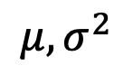
Population vs. Sample
Population
$$μ, σ^{2}$$
Notes:
Without programs that can harness the computational power of modern computers understanding large and complex datasets that describe the behavior of neural systems is practically inconceivable.

Slide 3
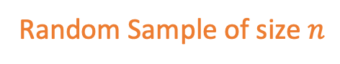
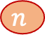
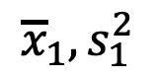
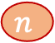
Population vs. Sample
Population
$$μ, σ^{2}$$
$$n$$
$${\overline{x}}_{1},s_{1}^{2}$$
Random Sample of size $n$
$$n$$
Notes:
Without programs that can harness the computational power of modern computers understanding large and complex datasets that describe the behavior of neural systems is practically inconceivable.

Slide 4
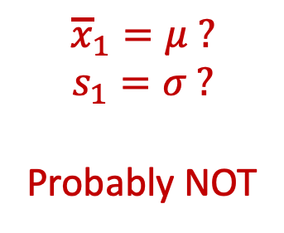
Population vs. Sample
Population
$$μ, σ^{2}$$
$$n$$
$${\overline{x}}_{1},s_{1}^{2}$$
Random Sample of size $n$
$$n$$
$${\overline{x}}_{1}=μ ?$$
$$s_{1}=σ ?$$
Probably NOT
Notes:
Without programs that can harness the computational power of modern computers understanding large and complex datasets that describe the behavior of neural systems is practically inconceivable.

Slide 5
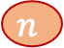
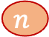
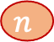
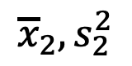
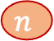
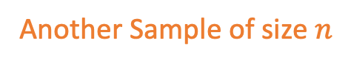
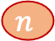
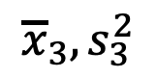
Population vs. Sample
Population
$$μ, σ^{2}$$
$$n$$
$$n$$
$$n$$
$${\overline{x}}_{1},s_{1}^{2}$$
Random Sample of size $n$
$$n$$
$$n$$
$$n$$
$${\overline{x}}_{2},s_{2}^{2}$$
Another Sample of size $n$
$$n$$
$${\overline{x}}_{3},s_{3}^{2}$$
Another Sample of size $n$
.
.
.
Notes:
Without programs that can harness the computational power of modern computers understanding large and complex datasets that describe the behavior of neural systems is practically inconceivable.

Slide 6
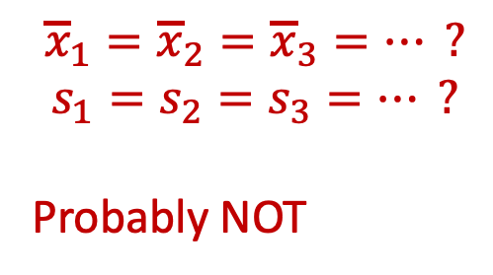
Population vs. Sample
Population
$$μ, σ^{2}$$
$$n$$
$$n$$
$$n$$
$${\overline{x}}_{1},s_{1}^{2}$$
Random Sample of size $n$
$$n$$
$$n$$
$$n$$
$${\overline{x}}_{2},s_{2}^{2}$$
Another Sample of size $n$
$$n$$
$${\overline{x}}_{3},s_{3}^{2}$$
Another Sample of size $n$
.
.
.
$${\overline{x}}_{1}={\overline{x}}_{2}={\overline{x}}_{3}=… ?$$
$$s_{1}=s_{2}=s_{3}=… ?$$
Probably NOT
Notes:
Without programs that can harness the computational power of modern computers understanding large and complex datasets that describe the behavior of neural systems is practically inconceivable.

Slide 7
Population vs. Sample
Population
$$μ, σ^{2}$$
$$n$$
$$n$$
$$n$$
$${\overline{x}}_{1},s_{1}^{2}$$
Random Sample of size $n$
$$n$$
$$n$$
$$n$$
$${\overline{x}}_{2},s_{2}^{2}$$
Another Sample of size $n$
$$n$$
$${\overline{x}}_{3},s_{3}^{2}$$
Another Sample of size $n$
.
.
.
Any statistic (e.g. mean, variance, etc.) has a distribution across samples.
Notes:
Without programs that can harness the computational power of modern computers understanding large and complex datasets that describe the behavior of neural systems is practically inconceivable.

Slide 8
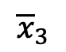
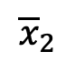
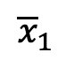
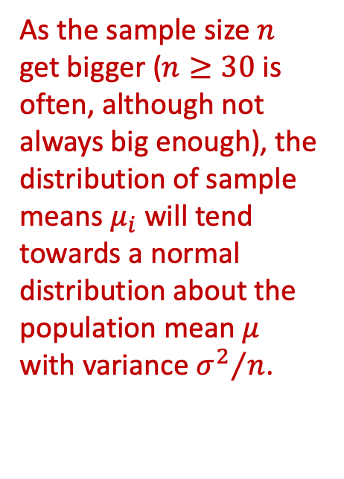
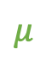
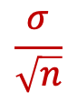
Central Limit Theorem
Population
As the sample size $n$ get bigger ($n≥30$ is often, although not always big enough), the distribution of sample means $μ_{i}$ will tend towards a normal distribution about the population mean $μ$ with variance ${σ^{2}}/n$.
$$μ, σ^{2}$$
$$n$$
$$n$$
$$n$$
$${\overline{x}}_{1},s_{1}^{2}$$
$$n$$
$$n$$
$$n$$
$${\overline{x}}_{2},s_{2}^{2}$$
$$n$$
$${\overline{x}}_{3},s_{3}^{2}$$
$$\frac{σ}{\sqrt{n}}$$
$${\overline{x}}_{1}$$
$${\overline{x}}_{2}$$
$${\overline{x}}_{3}$$
$$μ$$
Notes:
Without programs that can harness the computational power of modern computers understanding large and complex datasets that describe the behavior of neural systems is practically inconceivable.

Slide 9
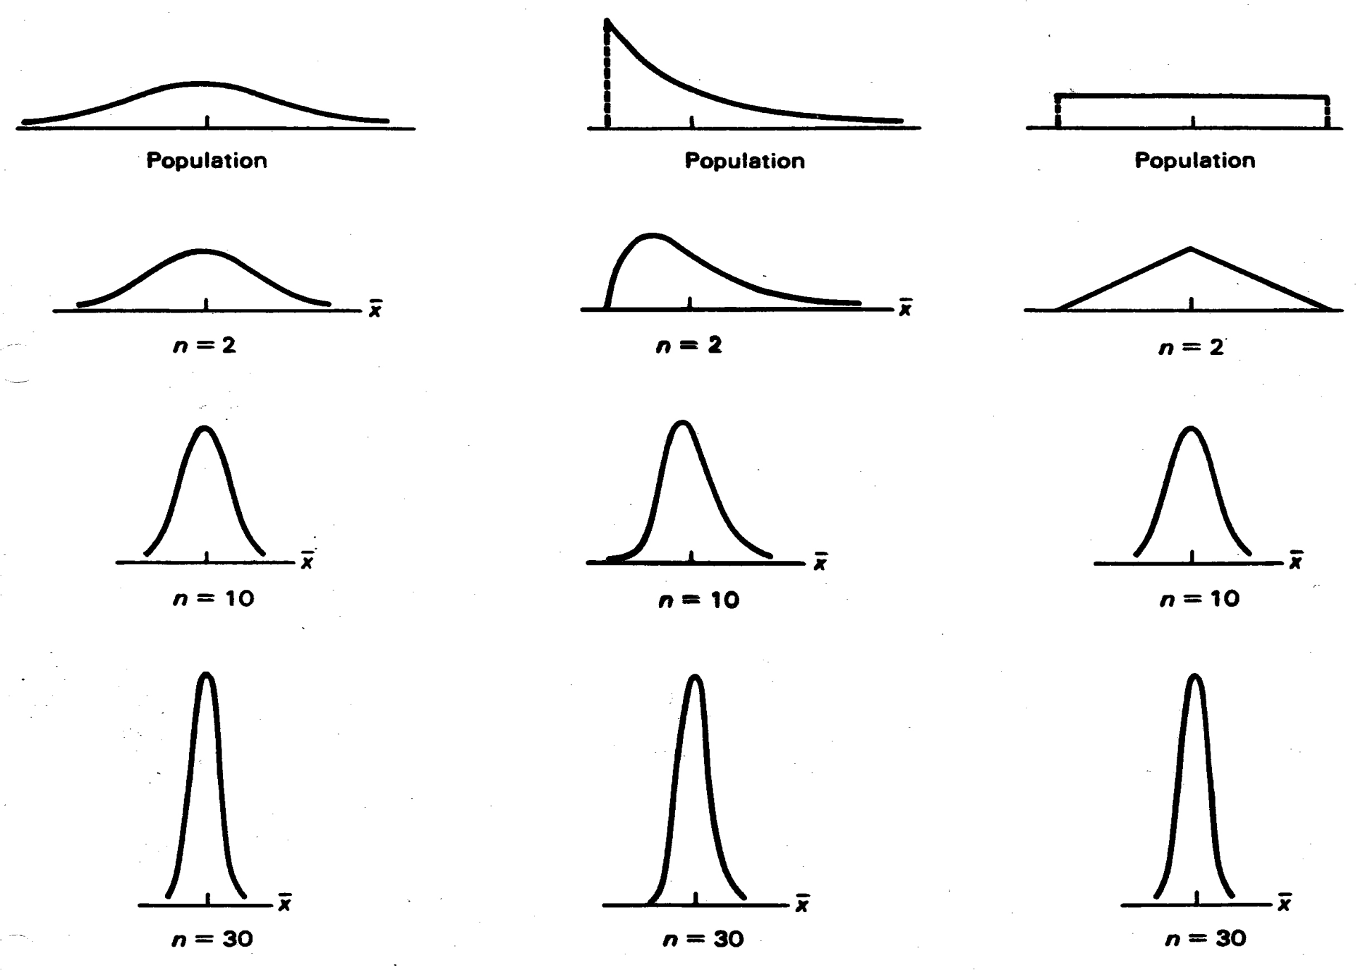
Central Limit Theorem
Notes:
Without programs that can harness the computational power of modern computers understanding large and complex datasets that describe the behavior of neural systems is practically inconceivable.

Slide 10
Normal-ish distributions are everywhere
Consider a complicated biological processes where the parameter that you measure results from the average of multiple underlying processes.
By the central limit theorem, we might expect our measurements to have a normal distribution even if the underlying processes do not.
Notes:
Without programs that can harness the computational power of modern computers understanding large and complex datasets that describe the behavior of neural systems is practically inconceivable.

Slide 11
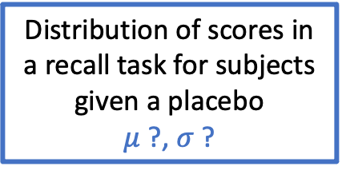
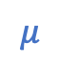
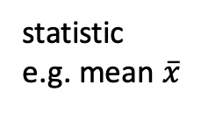
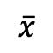
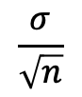
Null Hypothesis & p-values
Distribution of scores in a recall task for subjects given a placebo
$μ$ ?, $σ$ ?
$$\frac{σ}{\sqrt{n}}$$
Random sample of size n
$$\overline{x}$$
statistic
e.g. mean $\overline{x}$
$$μ$$
Notes:
Without programs that can harness the computational power of modern computers understanding large and complex datasets that describe the behavior of neural systems is practically inconceivable.

Slide 12
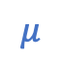
Null Hypothesis & p-values
Distribution of scores in a recall task for subjects given a placebo
$μ$ ?, $σ$ ?
$$\frac{σ}{\sqrt{n}}$$
Random sample of size n
$$μ$$
$$\overline{x}$$
statistic
e.g. mean $\overline{x}$
Notes:
Without programs that can harness the computational power of modern computers understanding large and complex datasets that describe the behavior of neural systems is practically inconceivable.

Slide 13
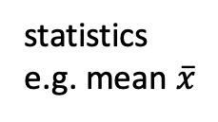
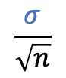
Null Hypothesis & p-values
Distribution of scores in a recall task for subjects given a placebo
$μ$ ?, $σ$ ?
$$\frac{σ}{\sqrt{n}}$$
Random samples of size n
$$μ$$
$$\overline{x}$$
statistics
e.g. mean $\overline{x}$
Notes:
Without programs that can harness the computational power of modern computers understanding large and complex datasets that describe the behavior of neural systems is practically inconceivable.

Slide 14
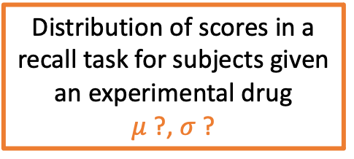
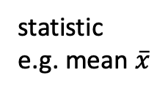
Null Hypothesis & p-values
Distribution of scores in a recall task for subjects given a placebo
$μ$ ?, $σ$ ?
Distribution of scores in a recall task for subjects given an experimental drug
$μ$ ?, $σ$ ?
$$\frac{σ}{\sqrt{n}}$$
Random samples of size n
Random sample of size n
$$μ$$
$$\overline{x}$$
statistics
e.g. mean $\overline{x}$
statistic
e.g. mean $\overline{x}$
Does the drug affect mean recall?
Notes:
Without programs that can harness the computational power of modern computers understanding large and complex datasets that describe the behavior of neural systems is practically inconceivable.

Slide 15
Null Hypothesis & p-values
Distribution of scores in a recall task for subjects given a placebo
$μ$ ?, $σ$ ?
Distribution of scores in a recall task for subjects given an experimental drug
$μ$ ?, $σ$ ?
$$\frac{σ}{\sqrt{n}}$$
Random samples of size n
Random sample of size n
$$μ$$
$$\overline{x}$$
statistics
e.g. mean $\overline{x}$
statistic
e.g. mean $\overline{x}$
Does the drug affect mean recall?
Notes:
Without programs that can harness the computational power of modern computers understanding large and complex datasets that describe the behavior of neural systems is practically inconceivable.

Slide 16
Null Hypothesis & p-values
Distribution of scores in a recall task for subjects given a placebo
$μ$ ?, $σ$ ?
Distribution of scores in a recall task for subjects given an experimental drug
$μ$ ?, $σ$ ?
$$\frac{σ}{\sqrt{n}}$$
Random samples of size n
Random sample of size n
$$μ$$
$$\overline{x}$$
statistics
e.g. mean $\overline{x}$
statistic
e.g. mean $\overline{x}$
Does the drug affect mean recall?
Notes:
Without programs that can harness the computational power of modern computers understanding large and complex datasets that describe the behavior of neural systems is practically inconceivable.

Slide 17
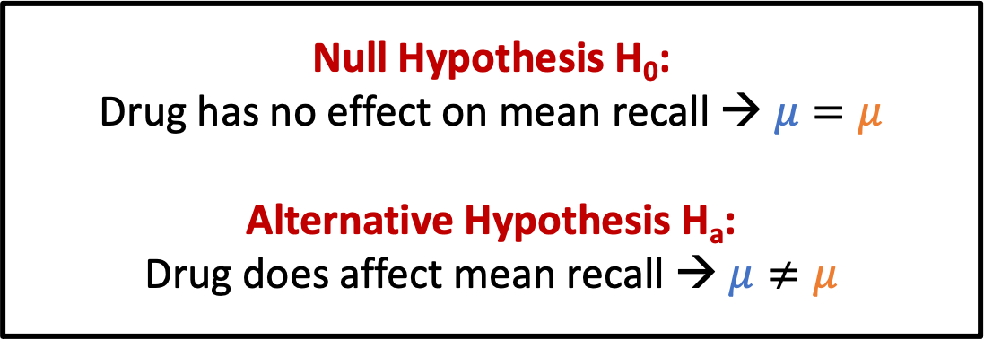
Null Hypothesis & p-values
Distribution of scores in a recall task for subjects given a placebo
$μ$ ?, $σ$ ?
Distribution of scores in a recall task for subjects given an experimental drug
$μ$ ?, $σ$ ?
Null Hypothesis H₀:
Drug has no effect on mean recall → $μ=μ$
Alternative Hypothesis H_{a}:
Drug does affect mean recall → $μ≠μ$
$$\frac{σ}{\sqrt{n}}$$
Random samples of size n
Random sample of size n
$$μ$$
$$\overline{x}$$
statistics
e.g. mean $\overline{x}$
statistic
e.g. mean $\overline{x}$
Does the drug affect mean recall?
Notes:
Without programs that can harness the computational power of modern computers understanding large and complex datasets that describe the behavior of neural systems is practically inconceivable.

Slide 18
Null Hypothesis & p-values
Notes:
Without programs that can harness the computational power of modern computers understanding large and complex datasets that describe the behavior of neural systems is practically inconceivable.

Slide 19
Null Hypothesis & p-values
Notes:
Without programs that can harness the computational power of modern computers understanding large and complex datasets that describe the behavior of neural systems is practically inconceivable.

Slide 20
Null Hypothesis & p-values
Notes:
Without programs that can harness the computational power of modern computers understanding large and complex datasets that describe the behavior of neural systems is practically inconceivable.

Slide 21
Null Hypothesis & p-values
Distribution of scores in a recall task for subjects given a placebo
$μ$ ?, $σ$ ?
Distribution of scores in a recall task for subjects given an experimental drug
$μ$ ?, $σ$ ?
reject H₀
do not reject H₀
reject H₀
$$\frac{σ}{\sqrt{n}}$$
Random samples of size n
v
Random sample of size n
$$μ$$
$$\overline{x}$$
statistics
e.g. mean $\overline{x}$
statistic
e.g. mean $\overline{x}$
p-value > 0.05 / 2 →
Do NOT reject H₀ → Infer drug has no effect
Notes:
Without programs that can harness the computational power of modern computers understanding large and complex datasets that describe the behavior of neural systems is practically inconceivable.

Slide 22
Null Hypothesis & p-values
!!! p-value calculations assume that the null hypothesis is correct.
Thus, from the p-value’s point of view, the null hypothesis is 100% true.
p-values assume that the null hypothesis is true, and that the observed sample effect is caused by random sample error.
!!! p-values tell you how consistent your data are with a null hypothesis that is true.
However, when your data are very inconsistent with the null hypothesis, p-values can’t determine which of the following is true:
The null hypothesis is true, but your sample is just unusual.
The null hypothesis is false.
!!! p-values ARE NOT the probability of any specific alternative hypothesis being true.
Notes:
Without programs that can harness the computational power of modern computers understanding large and complex datasets that describe the behavior of neural systems is practically inconceivable.

Slide 23
Power & Sample Size
e.g. control distribution
e.g. test distribution
Notes:
Without programs that can harness the computational power of modern computers understanding large and complex datasets that describe the behavior of neural systems is practically inconceivable.

Slide 24
Power & Sample Size
Type II Error
H₀ was false, but we didn’t reject it
Type I Error
H₀ was true, but we rejected it
Notes:
Without programs that can harness the computational power of modern computers understanding large and complex datasets that describe the behavior of neural systems is practically inconceivable.

Slide 25
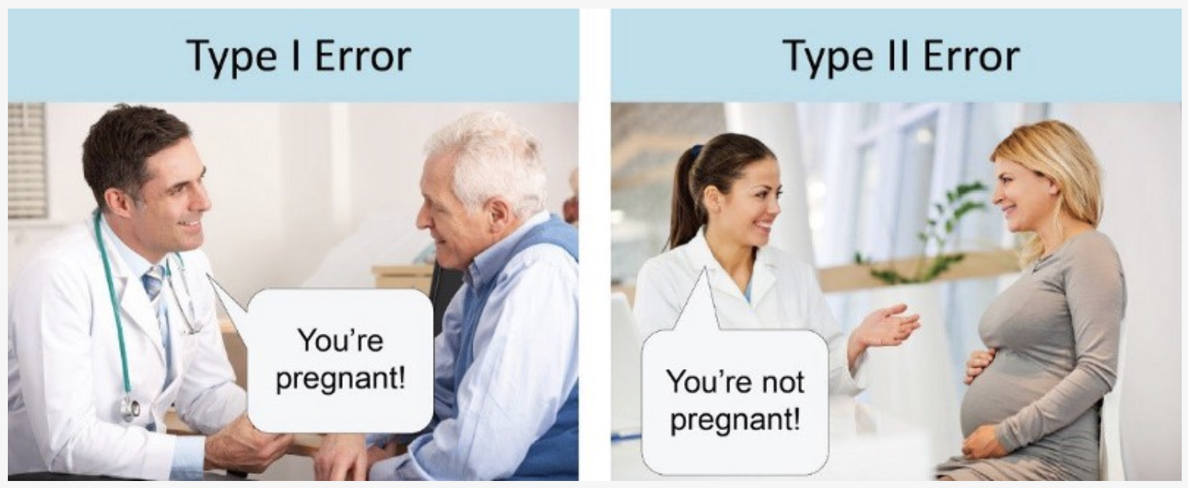
Power & Sample Size
Type II Error
H₀ was false, but we didn’t reject it
Type I Error
H₀ was true, but we rejected it
Notes:
Without programs that can harness the computational power of modern computers understanding large and complex datasets that describe the behavior of neural systems is practically inconceivable.

Slide 26
Power & Sample Size
Power
Probability that we actually reject H₀ when it is false
Type II Error
H₀ was false, but we didn’t reject it
1 – β = Power
Type I Error
H₀ was true, but we rejected it
Notes:
Without programs that can harness the computational power of modern computers understanding large and complex datasets that describe the behavior of neural systems is practically inconceivable.

Slide 27
Power & Sample Size
Small samples from populations A & B:
Low power
Notes:
Without programs that can harness the computational power of modern computers understanding large and complex datasets that describe the behavior of neural systems is practically inconceivable.

Slide 28
Power & Sample Size
Small samples from populations A & B:
Low power
Large samples from same populations A & B:
High power
Notes:
Without programs that can harness the computational power of modern computers understanding large and complex datasets that describe the behavior of neural systems is practically inconceivable.

Slide 29
Power & Sample Size
Small samples from populations A & B:
Low power
You can pretty much always get a significant p-value if you use a huge sample size.
However, the effect size may be so small as to be meaningless.
Large samples from same populations A & B:
High power
Notes:
Without programs that can harness the computational power of modern computers understanding large and complex datasets that describe the behavior of neural systems is practically inconceivable.

Slide 30
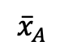
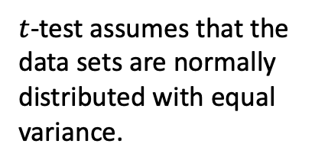
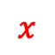
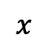
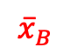
t-Test for sample means
data set A
data set B
x
x
x
x
x
$t$-test assumes that the data sets are normally distributed with equal variance.
x
x
x
x
x
x
x
x
x
x
x
x
x
x
x
x
x
x
x
x
x
x
x
x
x
x
x
x
x
x
x
x
x
x
x
x
x
x
x
$$x$$
$$x$$
$${\overline{x}}_{A}$$
$${\overline{x}}_{B}$$
mean
Notes:
Without programs that can harness the computational power of modern computers understanding large and complex datasets that describe the behavior of neural systems is practically inconceivable.

Slide 31
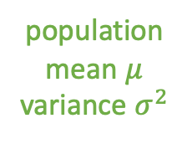
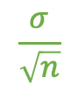

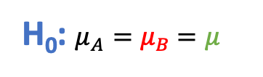
t-Test for sample means
data set A
data set B
x
x
x
x
population
mean $μ$
variance $σ^{2}$
x
x
x
x
x
x
x
x
x
x
x
x
x
x
x
x
x
x
x
x
x
x
x
x
x
x
x
x
x
x
x
x
x
x
x
x
x
x
x
x
H₀: $μ_{A}=μ_{B}$ $=μ$
$$\frac{σ}{\sqrt{n}}$$
$${\overline{x}}_{A}$$
$$μ$$
$${\overline{x}}_{B}$$
mean
Notes:
Without programs that can harness the computational power of modern computers understanding large and complex datasets that describe the behavior of neural systems is practically inconceivable.

Slide 32
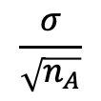
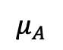
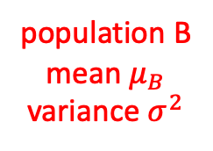
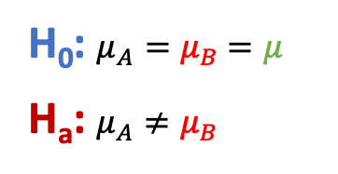
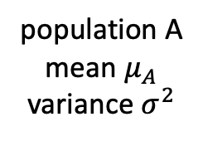
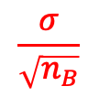
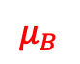
t-Test for sample means
data set A
data set B
population A
mean $μ_{A}$
variance $σ^{2}$
population B
mean $μ_{B}$
variance $σ^{2}$
x
x
x
x
x
x
x
x
x
x
x
x
x
x
x
x
x
x
x
x
x
x
x
x
x
x
x
x
x
x
x
x
x
x
x
x
x
x
x
x
x
x
x
x
H₀: $μ_{A}=μ_{B}$ $=μ$
H_{a}: $μ_{A}≠μ_{B}$
$$\frac{σ}{\sqrt{n_{A}}}$$
$$\frac{σ}{\sqrt{n_{B}}}$$
$${\overline{x}}_{A}$$
$${\overline{x}}_{B}$$
mean
$$μ_{A}$$
$$μ_{B}$$
Notes:
Without programs that can harness the computational power of modern computers understanding large and complex datasets that describe the behavior of neural systems is practically inconceivable.

Slide 33
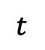



t-Test for sample means
data set A
data set B
x
x
x
x
x
x
x
x
x
x
x
x
x
x
x
x
x
x
x
x
x
x
x
x
x
x
x
x
x
x
x
x
x
x
x
x
x
x
x
x
x
x
x
x
$$t=\frac{{\overline{x}}_{A}−{\overline{x}}_{B}}{\sqrt{\frac{{s_{A}}^{2}}{n_{A}}+\frac{{s_{B}}^{2}}{n_{B}}}}$$
$t$-distribution
assuming H₀ is true
$p$-value:
probability of finding ${\overline{x}}_{A}>{\overline{x}}_{B}$ by at least as much as observed if $μ_{A}=μ_{B}$
0
$$t$$
Notes:
Without programs that can harness the computational power of modern computers understanding large and complex datasets that describe the behavior of neural systems is practically inconceivable.

Slide 34

t-Test: Sample from known distribution?
sample
x
x
x
x
x
x
x
x
x
x
x
distribution
mean $μ$
x
x
x
x
x
x
x
x
x
x
x
Does a single sample come from a known distribution with mean μ?
H₀: Sample comes from distribution with mean μ.
H_{a}: Sample does NOT come from distribution with mean μ.
Notes:
Without programs that can harness the computational power of modern computers understanding large and complex datasets that describe the behavior of neural systems is practically inconceivable.

Slide 35
t-Test: Are two independent samples from the same distribution?
sample A
sample B
x
x
x
x
x
x
x
x
x
x
x
x
x
x
x
x
x
x
x
x
x
x
x
x
x
x
x
x
x
x
x
x
x
x
x
x
x
x
x
x
x
x
x
x
Do two independent samples come from the same distribution?
H₀: Samples come from the same distribution.
H_{a}: Samples do NOT come from the same distribution.
Notes:
Without programs that can harness the computational power of modern computers understanding large and complex datasets that describe the behavior of neural systems is practically inconceivable.

Slide 36
t-Test: Are two pairwise-related samples from the same distribution?
sample A
sample B
x
x
x
x
x
x
x
x
x
x
x
x
x
x
x
x
x
x
x
x
x
x
x
x
x
x
x
x
x
x
x
x
x
x
x
x
x
x
x
x
x
x
x
x
Each sample in A is related to a unique sample in B.
Do two pairwise-related samples come from the same distribution?
H₀: Samples come from the same distribution.
H_{a}: Samples do NOT come from the same distribution.
Notes:
Without programs that can harness the computational power of modern computers understanding large and complex datasets that describe the behavior of neural systems is practically inconceivable.

Slide 37












Permutation Test
data set A
data set B
x
x
x
x
x
x
x
x
x
x
x
x
x
x
x
x
x
x
x
x
x
x
x
x
$$x_{0}$$
$$x_{1}$$
$$x_{2}$$
$$⋯$$
$$x_{N−1}$$
$$stat$$
x
x
x
x
$$x_{0}$$
$$x_{1}$$
$$x_{2}$$
$$⋯$$
$$x_{N−1}$$
$$stat$$
x
x
x
x
x
x
x
x
x
x
x
x
x
x
x
x
What if you can’t use a t-Test?
What if stat is not the mean?
What if you’re not sure about whether the samples come from normal-ish distributions with similar variance?

Slide 38
Permutation Test
data set A
data set B
x
x
x
x
x
x
x
x
x
x
x
x
x
x
x
x
x
x
x
x
x
x
x
x
$$x_{0}$$
$$x_{1}$$
$$x_{2}$$
$$⋯$$
$$x_{N−1}$$
$$stat$$
x
x
x
x
$$x_{0}$$
$$x_{1}$$
$$x_{2}$$
$$⋯$$
$$x_{N−1}$$
$$stat$$
x
x
x
x
x
x
x
x
x
x
x
x
x
x
x
x
Come from the same (H₀) or different (H_{a}) distributions?

Slide 39
Permutation Test
data set A
data set B
x
x
x
x
x
x
x
x
x
x
x
x
x
x
x
x
x
x
x
x
x
x
x
x
$$x_{0}$$
$$x_{1}$$
$$x_{2}$$
$$⋯$$
$$x_{N−1}$$
$$stat$$
x
x
x
x
$$x_{0}$$
$$x_{1}$$
$$x_{2}$$
$$⋯$$
$$x_{N−1}$$
$$stat$$
x
x
x
x
x
x
x
x
x
x
x
x
x
x
x
x
Come from the same (H₀) or different (H_{a}) distributions?
Assume H₀ is true.

Slide 40
Permutation Test
data set A
data set B
x
x
x
x
x
x
x
x
x
x
x
x
x
x
x
x
x
x
x
x
x
x
x
x
$$x_{0}$$
$$x_{1}$$
$$x_{2}$$
$$⋯$$
$$x_{N−1}$$
$$stat$$
x
x
x
x
$$x_{0}$$
$$x_{1}$$
$$x_{2}$$
$$⋯$$
$$x_{N−1}$$
$$stat$$
x
x
x
x
x
x
x
x
x
x
x
x
x
x
x
x
Come from the same (H₀) or different (H_{a}) distributions?
Assume H₀ is true.
Then it shouldn’t matter if we mix the two data sets together.

Slide 41
Permutation Test
data set A
data set B
x
x
x
x
x
x
x
x
x
x
x
x
x
x
x
x
x
x
x
x
x
x
x
x
$$x_{0}$$
$$x_{1}$$
$$x_{2}$$
$$⋯$$
$$x_{N−1}$$
$$stat$$
x
x
x
x
$$x_{0}$$
$$x_{1}$$
$$x_{2}$$
$$⋯$$
$$x_{N−1}$$
$$stat$$
x
x
x
x
x
x
x
x
x
x
x
x
x
x
x
x
Come from the same (H₀) or different (H_{a}) distributions?
Assume H₀ is true.
Then it shouldn’t matter if we mix the two data sets together.
Combine data sets A and B together, mix them up and then randomly grab new permuted data sets A* and B*.

Slide 42












































Permutation Test
data set A
data set B
x
x
x
x
x
x
x
x
x
x
x
x
x
x
x
x
x
x
x
x
x
x
x
x
$$x_{0}$$
$$x_{1}$$
$$x_{2}$$
$$⋯$$
$$x_{N−1}$$
$$stat$$
x
x
x
x
$$x_{0}$$
$$x_{1}$$
$$x_{2}$$
$$⋯$$
$$x_{N−1}$$
$$stat$$
x
x
x
x
x
x
x
x
x
x
x
x
x
x
x
x
Permutations:
same size
same size
x
x
x
x
x
x
x
x
x
x
x
x
x
x
x
x
x
x
x
x
x
x
$$x_{9}$$
$$x_{3}$$
$$x_{8}$$
$$⋯$$
$$x_{7}$$
$$stat∗$$
x
x
x
x
x
$$x_{2}$$
$$x_{5}$$
$$x_{4}$$
$$⋯$$
$$x_{0}$$
$$stat∗$$
x
x
x
x
x
x
x
x
x
x
x
x
x
x
x
x
x
x
x
x
x
x
x
x
x
x
x
x
x
x
x
x
x
x
x
x
x
x
x
x
x
$$x_{5}$$
$$x_{2}$$
$$x_{6}$$
$$⋯$$
$$x_{8}$$
$$stat∗$$
x
x
x
x
$$x_{6}$$
$$x_{3}$$
$$x_{9}$$
$$⋯$$
$$x_{3}$$
$$stat∗$$
x
x
x
x
x
x
x
x
x
x
x
x
x
x
x
x
x
x
x
x
x
x
x
x
x
x
x
x
x
x
x
x
x
x
$$x_{7}$$
$$x_{9}$$
$$x_{3}$$
$$x_{1}$$
$$stat∗$$
x
x
x
x
x
$$stat∗$$
x
$$⋯$$
x
$$x_{7}$$
$$x_{4}$$
$$x_{5}$$
$$⋯$$
$$x_{5}$$
x
x
x
x
x
x
x
x
x
x
x
x
x
x
x
x
x
x
x
x
x
x
x
x
x
x
x
x
x
x
x
x
x
x
x
x
x
x
x
x
x
$$x_{6}$$
$$x_{4}$$
$$x_{0}$$
$$⋯$$
$$x_{0}$$
$$stat∗$$
x
x
x
x
x
$$x_{9}$$
$$x_{8}$$
$$x_{5}$$
$$⋯$$
$$x_{1}$$
$$stat∗$$
x
x
x
x
x
x
x
x
x
x
x
x
x
x
x
x
x

Slide 43
Permutation Test
data set A
data set B
x
x
x
x
x
x
x
x
x
x
x
x
x
x
x
x
x
x
x
x
x
x
x
x
$$x_{0}$$
$$x_{1}$$
$$x_{2}$$
$$⋯$$
$$x_{N−1}$$
$$stat$$
x
x
x
x
$$x_{0}$$
$$x_{1}$$
$$x_{2}$$
$$⋯$$
$$x_{N−1}$$
$$stat$$
x
x
x
x
x
x
x
x
x
x
x
x
x
x
x
x
Permutations:
same size
same size
x
x
x
x
x
x
x
x
x
x
x
x
x
x
x
x
x
x
x
x
$$x_{9}$$
$$x_{3}$$
$$x_{8}$$
$$x_{7}$$
x
x
In principle, should do this for all possible permutations.
In practice, doing this for a large number (e.g. 1000) of random permutations works well (Monte Carlo).
x
x
$$⋯$$
$$stat∗$$
x
x
x
x
$$x_{2}$$
$$x_{5}$$
$$x_{4}$$
$$⋯$$
$$x_{0}$$
$$stat∗$$
x
x
x
x
x
x
x
x
x
x
x
x
x
x
x
x
x
x
x
x
x
x
x
x
x
x
x
x
x
x
x
x
x
x
x
x
x
x
x
x
$$x_{5}$$
$$x_{2}$$
$$x_{6}$$
$$⋯$$
$$x_{8}$$
$$stat∗$$
x
x
x
x
$$x_{6}$$
$$x_{3}$$
$$x_{9}$$
$$⋯$$
$$x_{3}$$
$$stat∗$$
x
x
x
x
x
x
x
x
x
x
x
x
x
x
x
x
x
x
x
x
x
x
x
x
x
x
x
x
x
x
x
x
x
x
$$x_{7}$$
$$x_{9}$$
$$x_{3}$$
$$x_{1}$$
$$stat∗$$
x
x
x
x
x
$$stat∗$$
x
$$⋯$$
x
$$x_{7}$$
$$x_{4}$$
$$x_{5}$$
$$⋯$$
$$x_{5}$$
x
x
x
x
x
x
x
x
x
x
x
x
x
x
x
x
x
x
x
x
x
x
x
x
x
x
x
x
x
x
x
x
x
x
x
x
x
x
x
x
x
$$x_{6}$$
$$x_{4}$$
$$x_{0}$$
$$⋯$$
$$x_{0}$$
$$stat∗$$
x
x
x
x
x
$$x_{9}$$
$$x_{8}$$
$$x_{5}$$
$$⋯$$
$$x_{1}$$
$$stat∗$$
x
x
x
x
x
x
x
x
x
x
x
x
x
x
x
x
x

Slide 44





























Permutation Test
data set A
data set B
x
x
x
x
x
x
x
x
x
x
x
x
x
x
x
x
x
x
x
x
x
$$stat−stat$$
x
x
x
$$x_{0}$$
$$x_{1}$$
$$x_{2}$$
$$⋯$$
$$x_{N−1}$$
x
x
x
x
$$x_{0}$$
$$x_{1}$$
$$x_{2}$$
$$⋯$$
$$x_{N−1}$$
x
x
x
x
x
x
x
x
x
x
x
x
x
x
x
x
Permutations:
same size
same size
x
x
x
x
x
x
x
x
x
x
x
x
x
x
x
x
x
x
x
x
x
x
$$x_{9}$$
$$x_{3}$$
$$x_{8}$$
$$⋯$$
$$x_{7}$$
x
x
x
x
x
$$x_{2}$$
$$x_{5}$$
$$x_{4}$$
$$⋯$$
$$x_{0}$$
$$stat∗− stat∗$$
x
x
x
x
x
x
x
x
x
x
x
x
x
x
x
x
x
x
x
x
x
x
x
x
x
x
x
x
x
x
x
x
x
x
x
x
x
x
$$stat∗− stat∗$$
x
x
x
$$x_{5}$$
$$x_{2}$$
$$x_{6}$$
$$⋯$$
$$x_{8}$$
x
x
x
x
$$x_{6}$$
$$x_{3}$$
$$x_{9}$$
$$⋯$$
$$x_{3}$$
x
x
x
x
x
x
x
x
x
x
x
x
x
x
x
x
x
x
x
x
x
x
x
x
x
x
x
x
x
x
x
x
x
x
$$x_{7}$$
$$x_{9}$$
$$x_{3}$$
$$x_{1}$$
x
x
x
x
x
$$stat∗− stat∗$$
x
$$⋯$$
x
$$x_{7}$$
$$x_{4}$$
$$x_{5}$$
$$⋯$$
$$x_{5}$$
x
x
x
x
x
x
x
x
x
x
x
x
x
x
x
x
x
x
x
x
x
x
x
x
x
x
x
x
x
x
x
x
x
x
x
x
x
x
x
x
x
$$x_{6}$$
$$x_{4}$$
$$x_{0}$$
$$⋯$$
$$x_{0}$$
x
x
x
x
x
$$x_{9}$$
$$x_{8}$$
$$x_{5}$$
$$⋯$$
$$x_{1}$$
$$stat∗− stat∗$$
x
x
x
x
x
x
x
x
x
x
x
x
x
x
x
x
x

Slide 45

Permutation Test
counts
0
$$stat∗− stat∗$$
from permutations

Slide 46
Permutation Test
counts
0
$$stat∗− stat∗$$
from permutations
confidence interval

Slide 47
Permutation Test
reject H₀
do NOT reject H₀
reject H₀
counts
0
$$stat∗− stat∗$$
from permutations
confidence interval

Slide 48

Permutation Test
reject H₀
do NOT reject H₀
reject H₀
counts
0
$$stat∗− stat∗$$
from permutations
$$stat−stat$$
from original data sets
confidence interval

Slide 49

Permutation Test
reject H₀
do NOT reject H₀
reject H₀
counts
0
$$stat∗− stat∗$$
from permutations
$$stat−stat$$
from original data sets
confidence interval

Slide 50
Bootstrap
data sample A
x
x
x
x
x
x
x
x
x
x
x
x
statistic
x
x
x
x
x
x
x
x
x
x
data sample B
x
x
x
x
x
x
x
x
x
x
x
x
statistic
x
x
x
x
x
x
x
x
x
x

Slide 51
Bootstrap
data samples
x
x
x
x
x
x
x
x
x
x
x
x
statistic
x
x
x
x
x
x
x
x
x
x
Will these be the same?
data sample B
x
x
x
x
x
x
x
x
x
x
x
x
statistic
x
x
x
x
x
x
x
x
x
x

Slide 52
Bootstrap
data samples
x
x
x
x
x
x
x
x
x
x
x
x
statistic
x
x
x
x
x
x
x
x
x
x
Will these be the same? Probably NOT.
Why?
data sample B
x
x
x
x
x
x
x
x
x
x
x
x
statistic
x
x
x
x
x
x
x
x
x
x

Slide 53
Bootstrap
data samples
x
x
x
x
x
x
x
x
x
x
x
x
statistic
x
x
x
x
x
x
x
x
x
x
Will these be the same? Probably NOT.
Why? Data samples are random variables.
data sample B
x
x
x
x
x
x
x
x
x
x
x
x
statistic
x
x
x
x
x
x
x
x
x
x

Slide 54
Bootstrap
x
x
x
x
x
x
x
x
x
x
x
x
statistic
x
x
x
x
x
x
x
x
x
x
x
x
x
x
x
x
x
x
x
x
x
x
statistic
x
x
x
x
x
x
x
x
x
x
x
x
x
x
x
x
x
x
counts or PDF
x
x
x
x
statistic
x
x
x
x
x
x
x
x
x
x
x
x
x
x
x
x
x
x
x
x
x
x
statistic
x
x
x
x
x
x
x
x
x
x
x
x
x
x
x
x
x
x
x
x
x
x
statistic
x
x
x
x
x
x
x
x
x
x
statistic
x
x
x
x
x
x
x
x
x
x
x
x
statistic
x
x
x
x
x
x
x
x
x
x

Slide 55
Bootstrap
x
x
x
x
x
x
x
x
x
x
x
x
statistic
x
x
x
x
x
x
x
x
x
x
x
x
x
x
x
x
x
x
x
x
x
x
statistic
x
x
x
x
x
x
x
x
x
x
x
x
x
x
x
x
x
x
counts or PDF
x
x
x
x
statistic
x
x
x
x
x
x
x
x
x
x
x
x
x
x
x
x
x
x
x
x
x
x
statistic
x
x
x
x
x
x
x
x
x
x
x
x
x
x
x
x
x
x
x
x
x
x
statistic
x
x
x
x
x
x
x
x
x
x
statistic
x
x
x
x
x
x
x
x
x
x
x
x
statistic
x
x
x
x
x
x
x
x
x
x

Slide 56
Bootstrap
x
x
x
x
x
x
x
x
x
x
x
x
statistic
x
x
x
x
x
x
x
x
x
x
x
x
x
x
x
x
x
x
x
x
x
x
statistic
x
x
x
x
x
x
x
x
x
x
x
x
x
x
x
x
x
x
counts or PDF
x
x
x
x
statistic
x
x
x
x
x
x
x
x
x
x
x
x
x
x
x
x
x
x
x
x
x
x
statistic
x
x
x
x
x
x
x
x
x
x
x
x
x
x
x
x
x
x
x
x
x
x
statistic
x
x
x
x
x
x
x
x
x
x
statistic
x
mean statistic
x
x
x
x
x
x
x
x
x
x
x
statistic
x
x
x
x
x
x
x
x
x
x
95% confidence interval

Slide 57


Bootstrap
x
x
x
x
x
x
x
x
x
x
x
x
statistic
x
x
x
x
x
x
x
x
x
x
x
x
x
x
x
x
x
x
x
x
x
x
statistic
x
x
x
x
x
x
x
x
x
x
x
x
x
x
x
$$σ$$
x
x
x
counts or PDF
x
x
x
x
statistic
x
x
x
x
x
x
x
x
x
x
x
x
x
x
x
x
x
x
x
x
x
x
statistic
x
x
x
x
x
x
x
$$1.96 σ$$
x
x
x
x
x
x
x
x
x
x
x
x
x
x
x
statistic
x
x
x
x
x
x
x
x
x
x
statistic
x
mean statistic
x
x
x
x
x
x
x
x
x
x
x
statistic
x
x
x
x
x
x
x
x
x
x
95% confidence interval

Slide 58
Bootstrap
x
x
x
x
x
x
x
x
x
x
x
x
statistic
x
x
x
x
x
x
x
x
x
x
You often only have a single data set.
statistic

Slide 59
Bootstrap
x
x
x
x
x
x
x
x
x
x
x
x
statistic
x
x
x
x
x
x
x
x
x
x
You often only have a single data set.
statistic
This is your only, and therefore best estimate of this statistic.

Slide 60
Bootstrap
x
x
x
what’s your confidence interval?
x
x
x
x
x
x
x
x
x
statistic
x
x
x
x
x
x
x
x
x
x
You often only have a single data set.
statistic
This is your only, and therefore best estimate of this statistic.

Slide 61
Bootstrap
x
x
x
what’s your confidence interval?
x
x
x
x
x
x
x
x
x
statistic
x
x
x
x
x
x
x
x
x
x
x
x
x
x
x
x
x
x
x
x
x
x
statistic
x
x
x
x
x
x
x
x
x
x
If you collected a new data set under different conditions and got this statistic, should you conclude that the new conditions affected the statistic, or that the difference from your previously measured statistic was simply due to random fluctuations and not an effect of changing conditions?
Without knowing a confidence interval, you cannot tell.
statistic
This is your only, and therefore best estimate of this statistic.

Slide 62
Bootstrap
Bootstrap is a method for estimating the distribution of a statistic from a single data set.
It is a nonparametric method. i.e. you don’t need to assume any type of model distribution.
It’s ONLY valid when the single data set in question is representative of the larger population.

Slide 63
Bootstrap
x
x
x
x
x
x
x
x
x
x
x
x
statistic
x
x
x
x
x
x
x
x
x
x
statistic

Slide 64
Bootstrap
x
x
x
x
x
x
x
x
x
x
x
x
statistic
x
x
x
x
x
x
x
x
x
x
Bootstrapped data sets
x
x
x
counts or PDF
x
x
x
x
x
x
x
x
x
statistic
x
x
x
x
x
x
x
x
x
x
x
x
x
x
x
x
x
x
x
x
x
x
statistic
x
x
x
x
x
x
x
x
x
x
x
x
x
x
x
x
x
x
x
x
x
x
statistic
x
x
x
x
x
x
x
bootstrapped statistic
x
x
x
x
x
x
x
x
x
x
x
x
x
x
x
statistic
x
x
x
x
x
x
x
x
x
x

Slide 65
Bootstrap
95% confidence interval
e.g. np.quantile(statistics, [0.025, 0.975])
x
x
x
x
x
x
x
x
x
x
x
x
statistic
x
x
x
x
x
x
x
x
x
x
Bootstrapped data sets
x
x
x
counts or PDF
x
x
x
x
x
x
x
x
x
statistic
x
x
x
x
x
x
x
x
x
x
x
x
x
x
x
x
x
x
x
x
x
x
statistic
x
x
x
x
x
x
x
x
x
x
x
x
x
x
x
x
x
x
x
x
x
x
statistic
x
x
x
x
x
x
x
bootstrapped statistic
x
x
x
x
x
x
x
x
x
x
x
x
x
x
x
statistic
x
x
x
x
x
x
x
x
x
x

Slide 66
Bootstrap
95% confidence interval
e.g. np.quantile(statistics, [0.025, 0.975])
x
x
x
x
x
x
x
x
x
x
x
x
statistic
x
x
x
x
x
x
x
x
x
x
Bootstrapped data sets
x
x
x
counts or PDF
x
x
x
x
x
x
x
x
x
statistic
x
x
x
x
x
x
x
x
x
x
x
x
x
x
x
x
x
x
x
x
x
x
statistic
x
x
x
x
x
x
x
x
x
x
x
x
x
x
x
x
x
x
x
x
x
x
statistic
x
x
x
x
x
x
x
bootstrapped statistic
x
x
x
x
x
x
x
x
x
x
x
x
x
x
x
statistic
x
x
x
x
x
x
x
x
x
x
This is your only, and therefore best estimate of this statistic.

Slide 67
Bootstrap
95% confidence interval
e.g. np.quantile(statistics, [0.025, 0.975])
x
x
x
x
x
x
x
x
x
x
x
x
statistic
x
x
x
x
x
x
x
x
x
x
statistic

Slide 68
Bootstrap
95% confidence interval
e.g. np.quantile(statistics, [0.025, 0.975])
x
x
x
x
x
x
x
x
x
x
x
x
statistic
x
x
x
x
x
x
x
x
x
x
x
x
x
x
x
x
x
x
x
x
x
x
statistic
x
x
x
x
x
x
x
x
x
x
statistic

